Slide 1
D

Slide 2
D Video
www.youtube.com/watch?v=HuN85RCLICQ

Slide 3
D
D
D
D

Slide 4
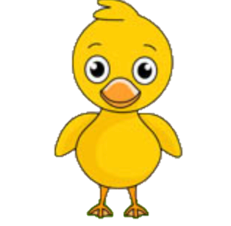
Let’s Read a Book
5 Little Ducks Swim a Pond

Slide 5
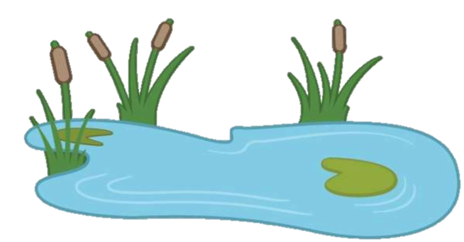
5 Little Duck Swims in a Pond

Slide 6

5 Little Ducks
https://www.youtube.com/watch?v=pZw9veQ76fo

Slide 7
D
D
D
D

Slide 8
D

