Slide 1
E

Slide 2
E Video
https://www.youtube.com/watch?v=Ccc2UfYmNu8

Slide 3
E
E
E
E

Slide 4
Let’s Play a Game: Point to the Letter E
E C

Slide 5
Let’s Play a Game: Point to the Letter E
E A

Slide 6
Let’s Read a Book Elmo Loves to Dance

Slide 7
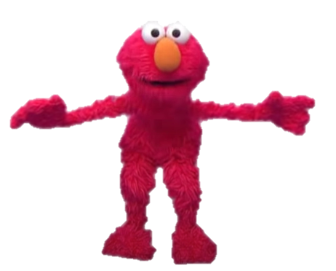
Elmo Dances to the Right

Slide 8
Elmo Dance to the Left

Slide 9
Elmo Dances Up

Slide 10
Elmo Dances Down

Slide 11
Elmo Dances Round and Round

Slide 12
Elmo
https://www.youtube.com/watch?v=07p9Yc7mZbk

Slide 13
E

