Slide 1
G

Slide 2
G Video
https://www.youtube.com/watch?v=XNqHltYP9Ps

Slide 3
G
G
G
G

Slide 4
Let’s Play a Game: Point to the Letter G
G E

Slide 5
Let’s Play a Game: Point to the Letter G
G A

Slide 6
The Giraffe is Hungry

Slide 7
Giraffe Walks Around the Water

Slide 8
The Giraffe Walks Close to the Tree

Slide 9
The Giraffe Eats the Grass

Slide 10
Giraffe Song
https://www.youtube.com/watch?v=ZrnE0XRMNqg

Slide 11
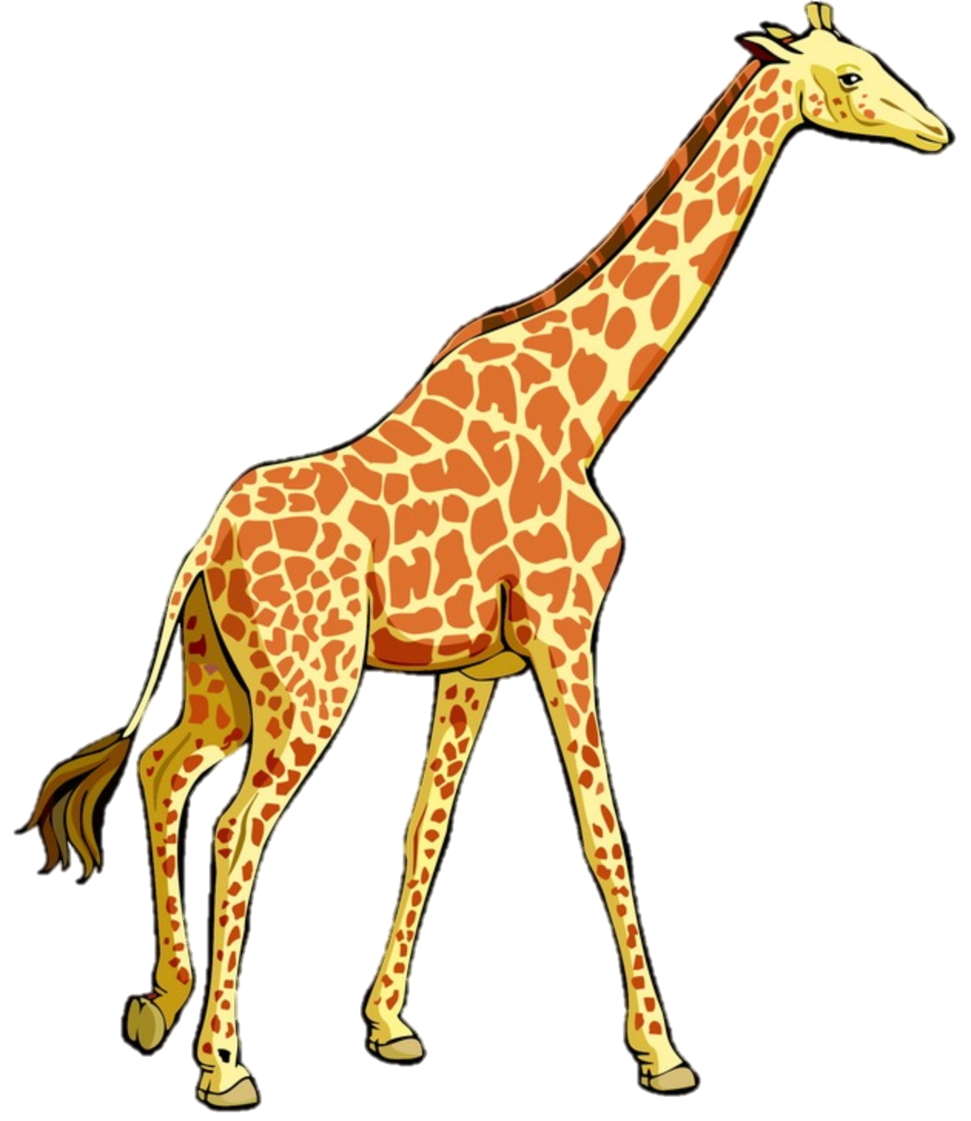

Let’s Read a Book
The Giraffe is Hungry

Slide 12


Giraffe Walks Around the Water

Slide 13


The Giraffe Walks Close to the Tree

Slide 14


The Giraffe Eats the Grass

Slide 15

Giraffe Song
https://www.youtube.com/watch?v=ZrnE0XRMNqg

Slide 16
G

