Slide 1
J

Slide 2
J Video
https://www.youtube.com/watch?v=GkcqRmdwKlE

Slide 3
J
J
J
J

Slide 4
Let’s Play a Game: Point to the Letter J
J K

Slide 5
Let’s Play a Game: Point to the Letter J
J D

Slide 6
Let’s Read a Book The Jellyfish Swims

Slide 7
Jellyfish is swimming down.

Slide 8
Jellyfish is swimming up.

Slide 9
Jellyfish gets big.

Slide 10
Jellyfish is swimming in circles.

Slide 11
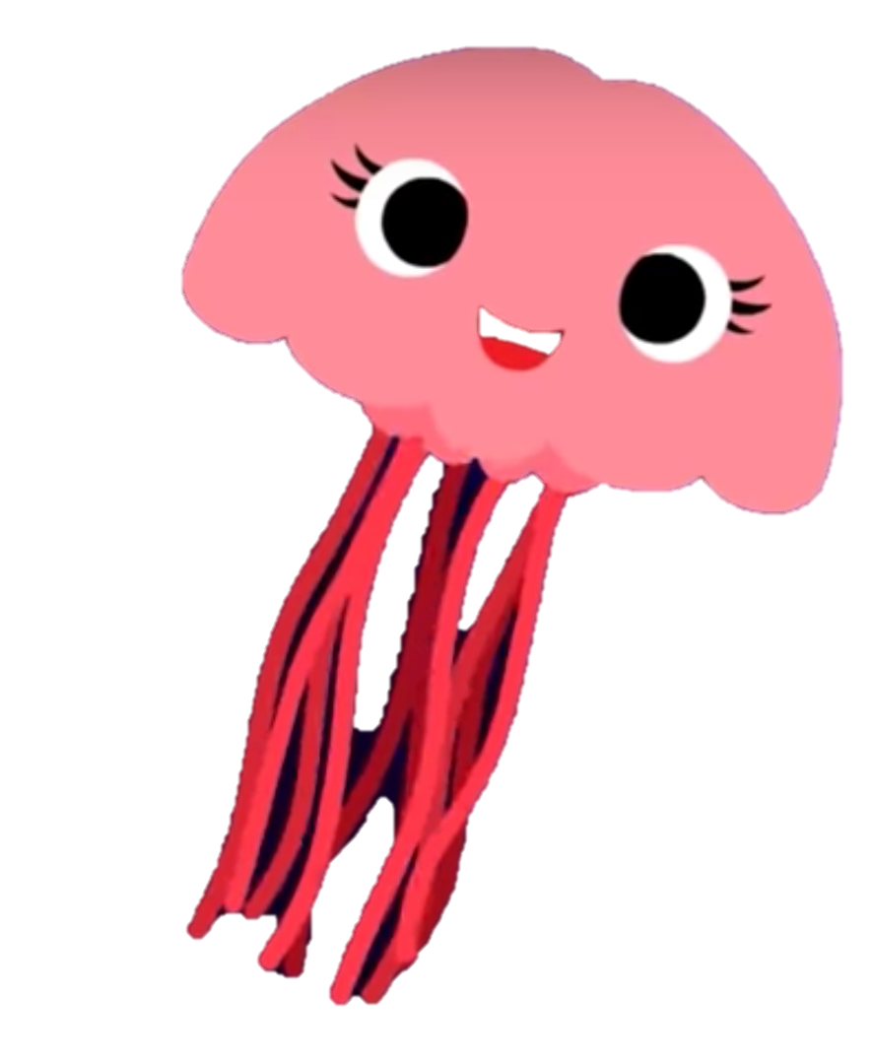
Jellyfish Song
https://www.youtube.com/watch?v=9kG7gwadFTg

Slide 12
J

