Slide 1
M

Slide 2
J Video
https://www.youtube.com/watch?v=GkcqRmdwKlE

Slide 3
M
M
M
M

Slide 4
Let’s Play a Game: Point to the Letter M
M O

Slide 5
Let’s Play a Game: Point to the Letter M
M T

Slide 6
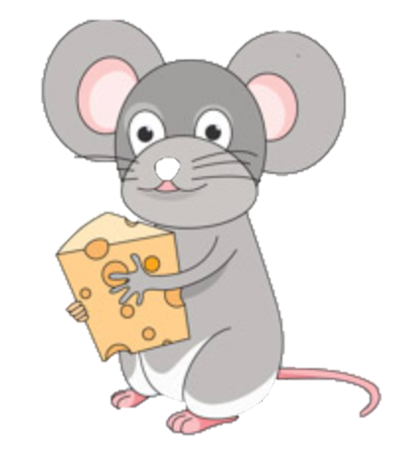
Let’s Read a Book The Mouse Finds the Cheese

Slide 7
The mouse looks for the cheese.

Slide 8
The mouse looks for the cheese.

Slide 9
The mouse looks for the cheese.

Slide 10
The mouse looks for the cheese.

Slide 11
Hickory Dickory Dock
https://www.youtube.com/watch?v=0eISTuHEnjY

Slide 12
M

