Slide 1
T

Slide 2

T Video
https://www.youtube.com/watch?v=iPHaID7o_5U

Slide 3
T
T
T
T

Slide 4

Let’s Read a Book
The Teddy Bear Wants to Go to Bed

Slide 5
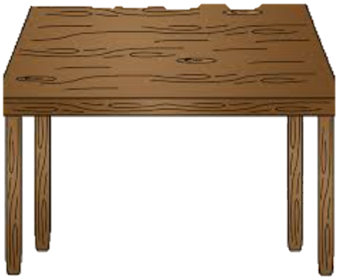
Teddy Bear Finds a Table

Slide 6

Teddy Bear Finds a Rug

Slide 7

The Teddy Bear Finds a Couch

Slide 8

Teddy Bear Finds a Chair

Slide 9

Teddy Bear Finds the Bed

Slide 10
The Teddy Bear Song
https://www.youtube.com/watch?v=5KhXLg6Y7WA

Slide 11
T
T
T
T

Slide 12
T

