Slide 1
S

Slide 2

T Video
https://www.youtube.com/watch?v=McACiO5dwGM

Slide 3
S
S
S
S

Slide 4

Let’s Read a Book
The Sun Shines Bright

Slide 5

The Sun Shines Over the Trees

Slide 6

The Sun Shines Over the Water

Slide 7

The Sun Shines Over the Land

Slide 8
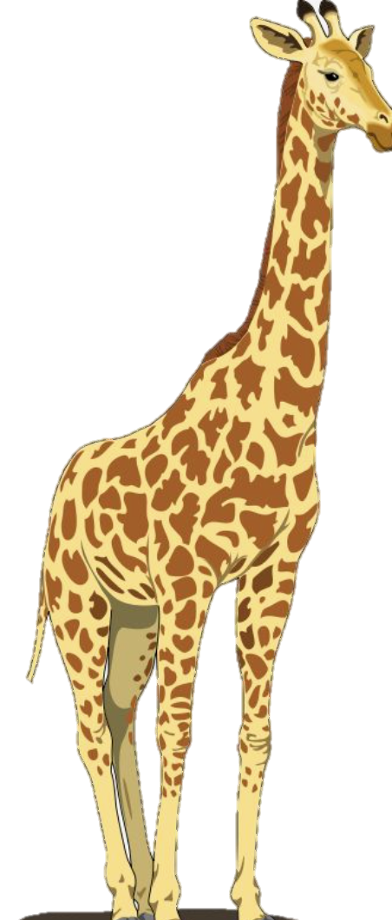


The Sun Shines Over the Animals

Slide 9


The Sun Shines Over the Kids

Slide 10

Oh Mr. Sun
https://www.youtube.com/watch?v=hlzvrEfyL2Y

Slide 11
S
S
S
S

Slide 12
S

